Slide 1
Server fingerprinting
How I broke most famous recon tools and made the script kiddies sad
Page 1
@0x48piraj
Notes:
Bsides Delhi 2019

Slide 2
$ whoami
Undergraduate student at --REDACTED-- University
Google Code In Contribution Winner, GSoC ‘19 Intern OWASP Foundation, Open source enthusiast
Independent security researcher, have given chronic nightmares to Canon (CVE-2019-14339), Motorola, IIT-B, IIT-M, Cornell, United Nations, Mozilla Firefox (Android & iOS), Opera Mini (Android), NodeJS modules, Samsung, LG Electronics, Dutch & Indian Govt.
cat > bio.info
… more uninteresting information goes here
CTRL + Z [1]+ Stopped cat > bio.info
Page 2
@0x48piraj
Notes:
Bsides Delhi 2019

Slide 3
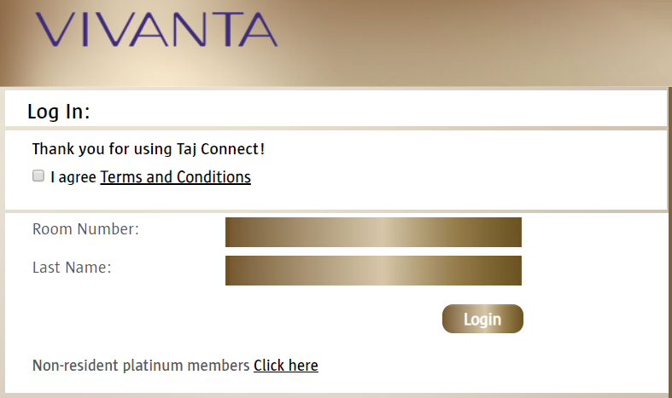
$ whoami, cont.
Came in yesterday, got in my lovely room (thanks, BSides team), went on to “review” my presentation, my network was struggling with poor signals and thought about using Vivanta’s (SSID: Vivanta_Dwarka) awesome WiFi Network.
Page 3
@0x48piraj
Notes:
Bsides Delhi 2019

Slide 4
$ whoami, cont.
Eh, just room number and last name?
Numerous natural options popped in instantly -
Social engineering (I’m looking for “xyz”, can you please help?)
Bruteforce attack (is it 203?, 302?, 230? Yes!)
Dictionary attack
Social engg. + Bruteforce (Excuse me, can you look for “xyz”?)
Information leakage (dumpster diving?)
Exploring the target web-app looking for vulnz
Page 4
@0x48piraj
Notes:
Bsides Delhi 2019

Slide 5
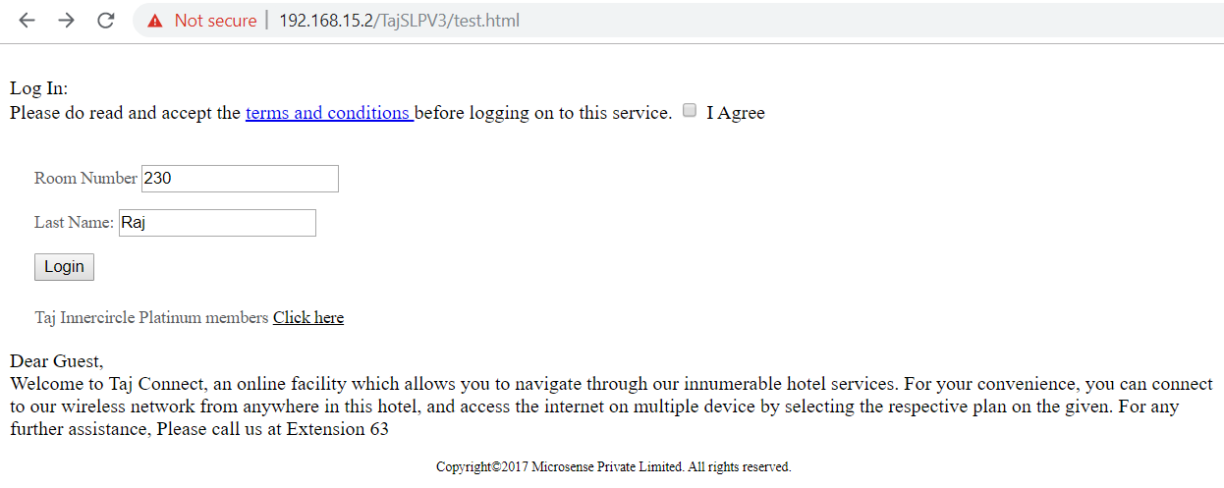
$ whoami, cont.
left-over test code found during brute-forcing obvious directories.
Page 5
@0x48piraj
Notes:
Bsides Delhi 2019

Slide 6
$ whoami, cont.
Fortunately or unfortunately (depends on your perspective), the error prevented further exploitation.
During testing, I also found Trace.axd which said,
Page 6
@0x48piraj
Notes:
Bsides Delhi 2019

Slide 7
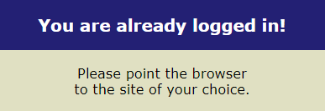
$ whoami, cont.
Found multiple endpoints during my assessment -
192.168.15.2 (http://192.168.15.2/TajSLPV3/)
124.153.110.196 (http://124.153.110.196/TajMemberNew/*)
192.168.15.3 (very interesting)
More ...
Page 7
@0x48piraj
Notes:
Bsides Delhi 2019

Slide 8
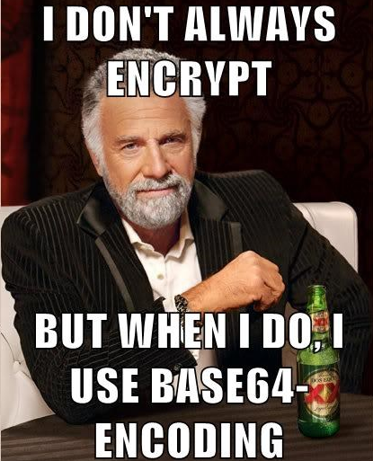
$ whoami, cont.
Essentially, the login structure of the URL was,
http://192.168.15.2/TajSLPV3/mifilogin.aspx?encry=VUk9MDJkMjI2JlVVUkw9aHR0cDovLzE---REDATED---NTkmT1M9aHR0cDovLzE5Mi4xNjguMTUuMy8mU0M9MTg4ODc=
Yeah, so it’s basically,
http://192.168.15.2/TajSLPV3/mifilogin.aspx?encry=BASE64_CHUNK
Page 8
@0x48piraj
Notes:
Bsides Delhi 2019

Slide 9
$ whoami, cont.
Decoding the BASE64_CHUNK gave something like,
When Unauthenticated
UI=02d226&UURL=http://192.168.15.3:1111/usg/userok.htm&MA=D0F88CAAF6AB&RN=80&PORT=80&RAD=no&PP=no&PMS=no&SIP=10.0.2.159&OS=http://192.168.15.3/&SC=18887
When Authenticated
&UI=02d226&UURL=http://192.168.15.3:1111/usg/userok.htm&MA=D0F88CAAF6AB&RN=80&PORT=80&RAD=no&PP=no&PMS=no&SIP=10.0.2.110&OS=http://www.msftconnecttest.com/redirect&SC=25869&logid=7C2A3139608901012019661143827
Page 9
@0x48piraj
Notes:
Bsides Delhi 2019

Slide 10
$ whoami, cont.
Demystifying the process flow
1) User connects to the WiFi
2) When certain user launches browser, he/she gets redirected by the Nomadix to Taj’s portal page, Nomadix redirects the user through a user ID for the session (their MAC address)
Eg: http://IP_ADDRESS:1111/usg/userok.htm?MA=
Yep, the MA parameter holds device’s MAC address.
Page 10
@0x48piraj
Notes:
Bsides Delhi 2019

Slide 11
$ whoami, cont.
3) The client website checks to see if certain MAC address has been captured before if it has, immediately makes a POST to Nomadix, if the MAC address has not been captured before then it asks for user info (e.g. Room, Last name).
On successful authentication the Web server tells the Nomadix Gateway that certain user can use the internet (service levels are defined). This is done from the web server as a POST to one of the following addresses:
http://:1111/usg/command.xml http://:1112/usg/command.xml
4) The Nomadix then manages certain user’s session until it expires.
Page 11
@0x48piraj
Notes:
Bsides Delhi 2019

Slide 12
$ whoami, cont.
Testing time, capturing the encry= parameter from an authenticated user, i.e. my laptop, decoding, modifying the MAC address, encoding again, then taking another device, and triggering our newly crafted payload results in:
Page 12
@0x48piraj
Notes:
Bsides Delhi 2019

Slide 13
$ whoami, cont.
And we all know how to collect lots and lots of MAC addresses, as MAC addresses are sent unencrypted. The reason for this is, MAC addresses are part of the OSI Data Link layer (level 2) and are visible in packets even if encryption such as WEP / WPA2 is used.
Commands:
wlan=`iw dev | awk '$1=="Interface"{print $2}'`
tshark -a duration:100 -i $wlan -T fields -e eth.src | sort | uniq
Page 13
@0x48piraj
Notes:
Bsides Delhi 2019

Slide 14
$ whoami, cont.
The following “greet message” pretty much covers as our Addendum
Dear Guest,
Welcome to Taj Connect, an online facility which allows you to navigate through our innumerable hotel services. For your convenience, you can connect to our wireless network from anywhere in this hotel, and access the internet on multiple devices by selecting the respective plan on the given device.
Page 14
@0x48piraj
Notes:
Bsides Delhi 2019

Slide 15
Notes:
Bsides Delhi 2019

Slide 16
This talk contains
How famous reconnaissance tools work
Current fingerprinting methods
Bad jokes, obviously
Screwing with script kiddies (everyone’s dream, right?)
Page 16
@0x48piraj
Notes:
Bsides Delhi 2019

Slide 17
This talk contains
Providing
“defensive strategies”
to companies
How famous reconnaissance tools work
Fingerprinting methods
Bad jokes, obviously
Screwing with script kiddies (everyone’s dream, right ?)
Page 17
@0x48piraj
Notes:
Bsides Delhi 2019

Slide 18
DISCLAIMER
This research presented herein was conducted and completed as an independent researcher, none of the research presented herein was conducted under the auspices of my current organisation.
The views, information and opinions expressed in this presentation and it's associated research paper are mine only and do not reflect the views, information or opinions of my current organisation.
Page 18
@0x48piraj
Notes:
Bsides Delhi 2019

Slide 19
So, what’s going on?
There are several different vendors and versions of web servers on the market today.
Knowing the version and type of a running web server allows testers to determine known vulnerabilities and the appropriate exploits to use during testing.
Page 19
@0x48piraj
Notes:
Bsides Delhi 2019

Slide 20
Okay, but, what is server fingerprinting?
That very process is called web application fingerprinting, identifying the type/version of the web server/application.
Page 20
@0x48piraj
Notes:
Bsides Delhi 2019

Slide 21
More on “how”
By knowing how each type of web server responds to specific payload (i.e. request) and keeping this information in a fingerprint database, a tester can send these payloads to the web server, analyze the response, and compare it to the database of known signatures revealing useful information. (i.e. tech-stack/server/app/OS)
Page 21
@0x48piraj
Notes:
Bsides Delhi 2019

Slide 22
Let’s not confuse
Many types of fingerprinting methods.
Operating system or say, TCP/IP stack (Nmap)
Web-stack (Wappalyzer, BuiltWith, etc.)
Protocol based
e.g. HTTP protocol behaviour (best*)
e.g. HTTP response header
--INSERT--
*with statistical analysis, combined with fuzzy logic techniques
Page 22
@0x48piraj
Notes:
Bsides Delhi 2019

Slide 23
Let’s talk about OS fingerprinting
Collection of configuration attributes from a remote device during standard layer 4 network communications. The combination of parameters may then be used to infer the remote machine's operating system. Two types of methods are used,
Active fingerprinting
Passive fingerprinting
Page 23
@0x48piraj
Notes:
Bsides Delhi 2019

Slide 24
Active/Passive
Active fingerprinting is accomplished by sending specially crafted packets to a target machine and then noting down its response and analyzing the gathered information to determine the target OS.
Passive fingerprinting is based on sniffing traces from the remote system and determining the operating system of the remote host. (not used by Nmap)
Page 24
@0x48piraj
Notes:
Bsides Delhi 2019

Slide 25
TCP/IP fields which are used in fingerprinting,
Initial packet size (16 bits)
Initial TTL (8 bits)
Window size (16 bits)
Max segment size (16 bits)
Window scaling value (8 bits)
"don't fragment" flag (1 bit)
"sackOK" flag (1 bit)
"nop" flag (1 bit)
Just inspecting the Initial TTL and window size fields is often enough in order to successfully identify an operating system.
Page 25
@0x48piraj
Notes:
Bsides Delhi 2019

Slide 26
Generalized Nmap Working
Nmap fingerprints a system in three steps,
Performs a port scan to find a set of open and closed TCP and UDP ports.
Generates specially formed packets, sends them to the remote host, and listens for responses. (performs 7 tests)
Uses the results from the tests to find a matching entry in its database of fingerprints.
Page 26
@0x48piraj
Notes:
Bsides Delhi 2019

Slide 27
Fooling OS fingerprinting tools ‘how-to’
For fooling Nmap, or any other OS fingerprinting tool, we will have to make patches to the Linux kernel because the aim is to change Linux TCP/IP stack behavior, and if we want to achieve it, we need to do it in the kernel layer.
Page 27
@0x48piraj
Notes:
Bsides Delhi 2019

Slide 28
Existing Research
A practical approach for defeating Nmap OS-Fingerprinting by David Barroso Berrueta (Google “defeat-nmap-osdetect”)
Defeating TCP/IP Stack Fingerprinting by Matthew Smart G., Robert Malan and Farnam Jahanian from University of Michigan (9th USENIX Security Symposium Paper 2000)
There are cool modules available such as IP Personality (don’t use Fingerprint fucker) which work out-of-the-box so writing from scratch doesn’t makes too much sense.
Page 28
@0x48piraj
Notes:
Bsides Delhi 2019

Slide 29
Wappalyzer
Wappalyzer is a cross-platform utility that uncovers the technologies used on websites.
Page 29
@0x48piraj
Notes:
Bsides Delhi 2019

Slide 30
The favourite tool for script kiddies
Wappalyzer has Chrome and Firefox extensions.
Page 30
@0x48piraj
Notes:
Bsides Delhi 2019

Slide 31
Open-source <3
Wappalyzer is free and open-source. The source code is available under the GPL v3 licence.
Page 31
@0x48piraj
Notes:
Bsides Delhi 2019

Slide 32
Deep diving into the code
Code structure of the Wappalyzer
Understanding the repository at high level
Internal workings
Finding vulnerabilities
Attacking the application
Page 32
@0x48piraj
Notes:
Bsides Delhi 2019

Slide 33
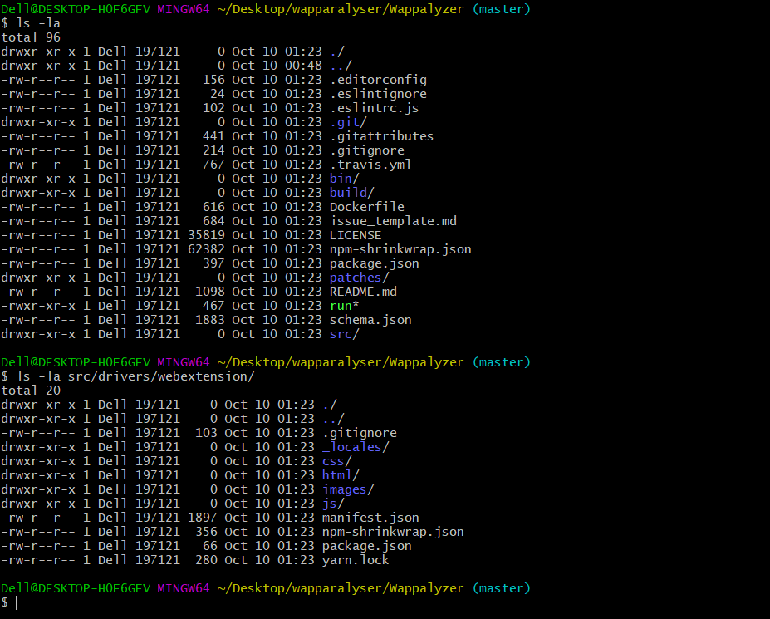
Structure
Page 33
@0x48piraj
Notes:
Bsides Delhi 2019

Slide 34
Deep diving into the code
Interesting files to look into:
Wappalyzer/src/wappalyzer.js
Wappalyzer/src/apps.json
Wappalyzer/src/drivers/*.*
Wappalyzer/src/drivers/webextension/js/*.*
Page 34
@0x48piraj
Notes:
Bsides Delhi 2019

Slide 35
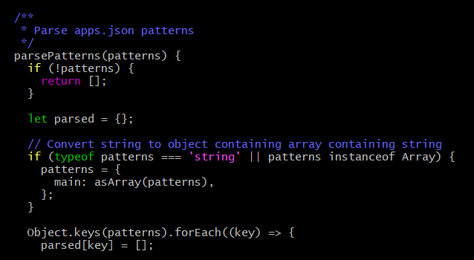
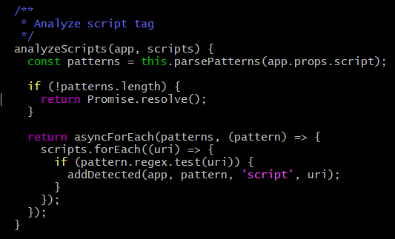
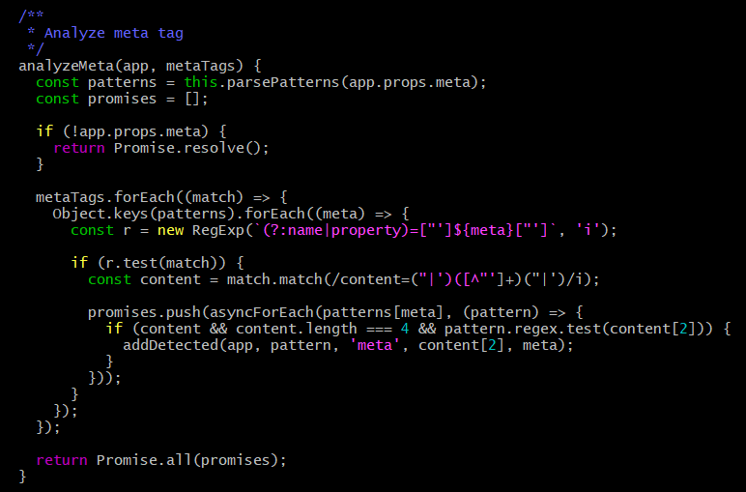
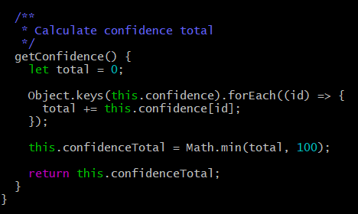
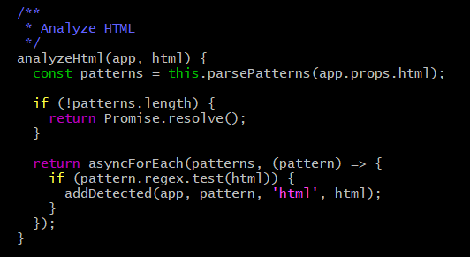
Deep diving into the code
Wappalyzer/src/wappalyzer.js
Page 35
@0x48piraj
Notes:
Bsides Delhi 2019

Slide 36
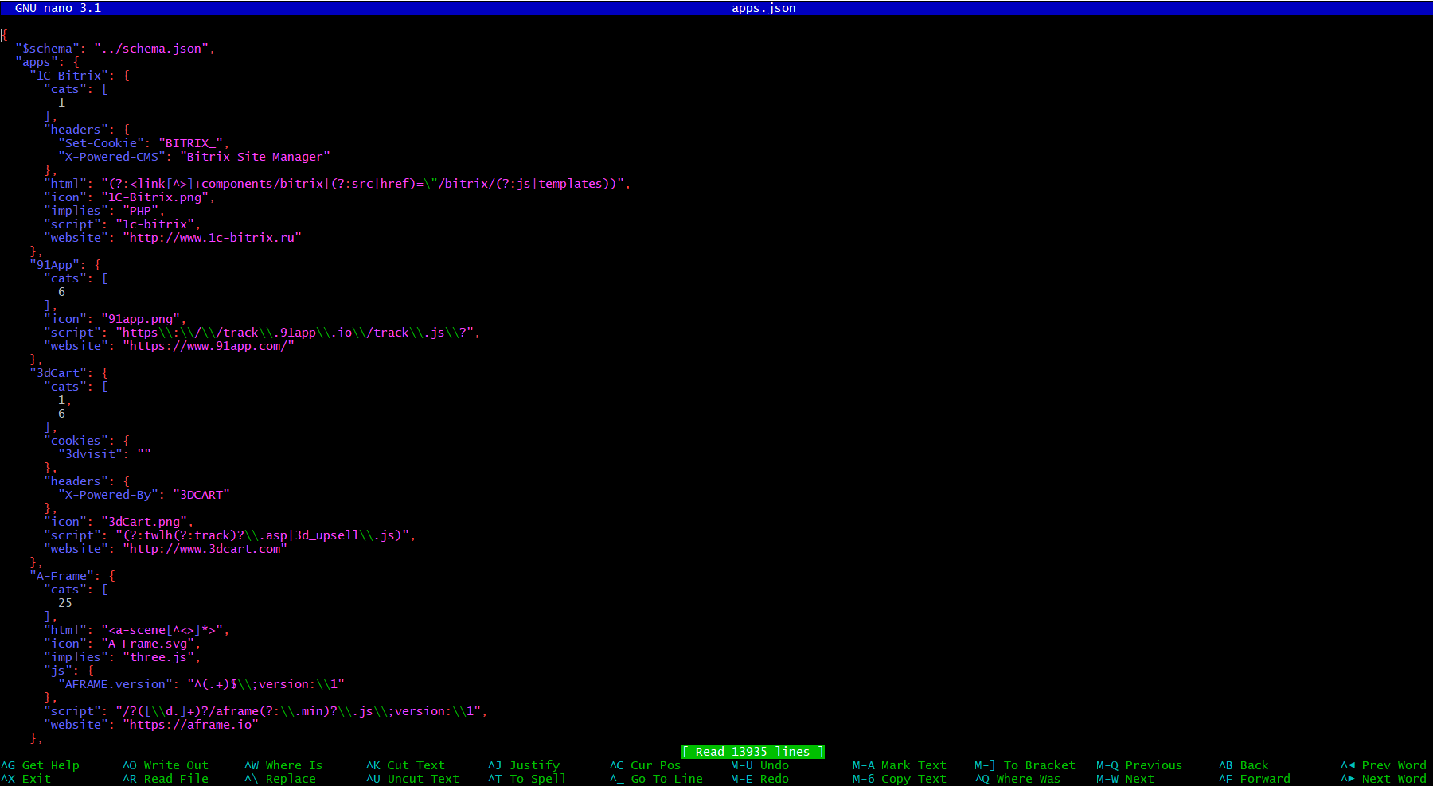
Deep diving into the code
Wappalyzer/src/apps.json
Page 36
@0x48piraj
Notes:
Bsides Delhi 2019

Slide 37
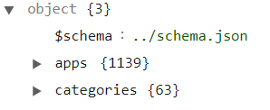
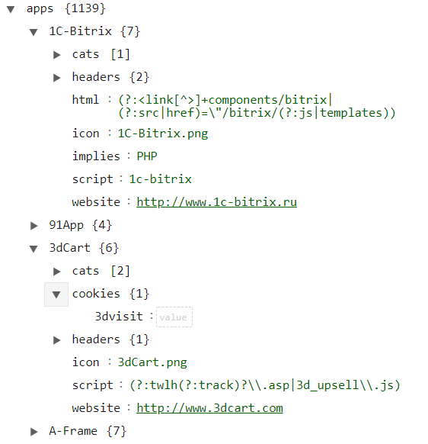
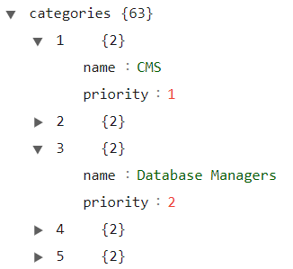
Structure of apps.json
apps sub-node
root node
categories sub-node
Page 37
@0x48piraj
Notes:
Bsides Delhi 2019

Slide 38
Pattern matching is CoOL
From seeing the code, it’s trivial to conclude that the application uses custom regex/regexp to parse specific features, validates using apps.json which holds lots and lots of “patterns”, uses fancy function named getConfidence() to calculate the confidence score.
AliasIO/Wappalyzer/src/wappalyzer.js#L105
Page 38
@0x48piraj
Notes:
Bsides Delhi 2019

Slide 39
???
Page 39
@0x48piraj
Notes:
Bsides Delhi 2019

Slide 40
Testing slash Fuzzing
Which programming language to write the fuzzer ?
C, Java
Javascript
PHP
Python
Page 40
@0x48piraj
Notes:
Bsides Delhi 2019

Slide 41
Choosing language
Sorry for this slide, had too much of coke
Page 41
@0x48piraj
Notes:
Bsides Delhi 2019

Slide 42
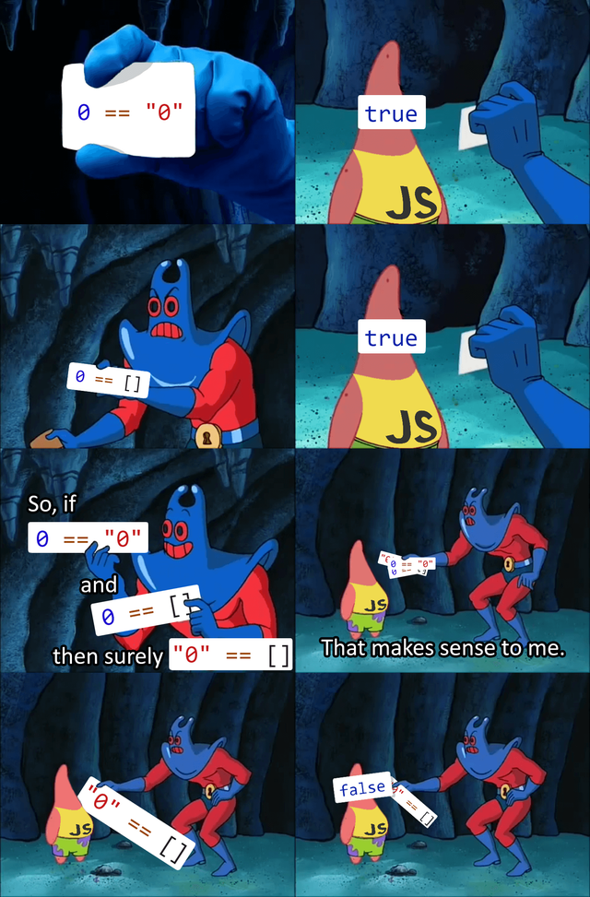
Choosing language
thank u, next
Page 42
@0x48piraj
Notes:
Bsides Delhi 2019

Slide 43
Choosing language
JS Object Model is just great.
Strings
"WAT" + 1 >>> "WAT1"
"WAT" - 1 >>> NaN
Dict
[] + {} >>> [object Object]
{} + [] >>> 0
[] == [] >>> false (Obviously.)
Page 43
@0x48piraj
Notes:
Bsides Delhi 2019

Slide 44
Choosing language
The carbon-dated option
Page 44
@0x48piraj
Notes:
Bsides Delhi 2019

Slide 45
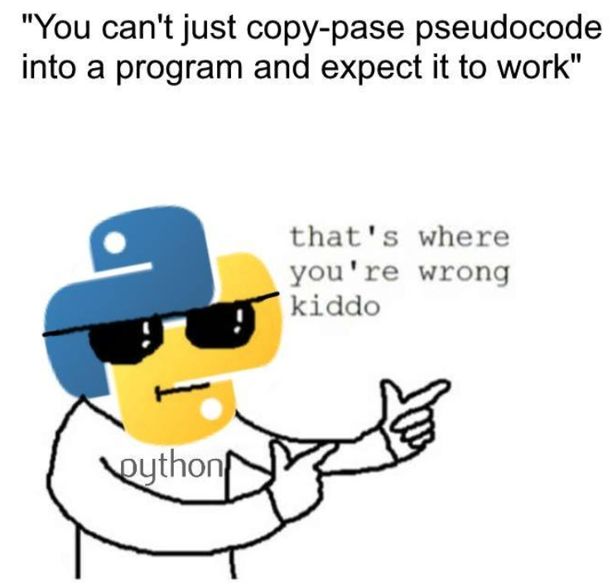
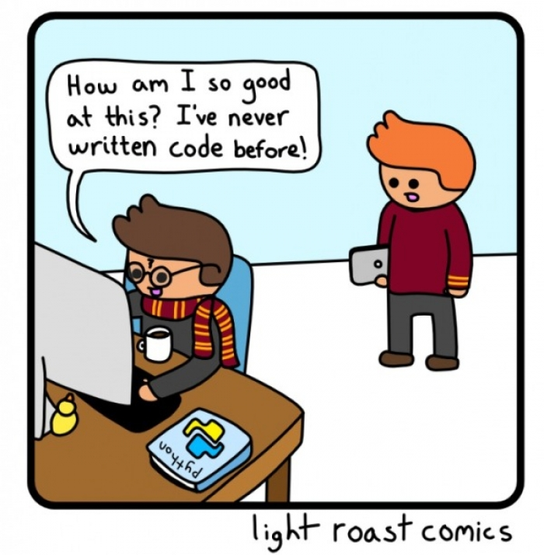
Let’s get Pythonic
Page 45
@0x48piraj
Notes:
Bsides Delhi 2019

Slide 46
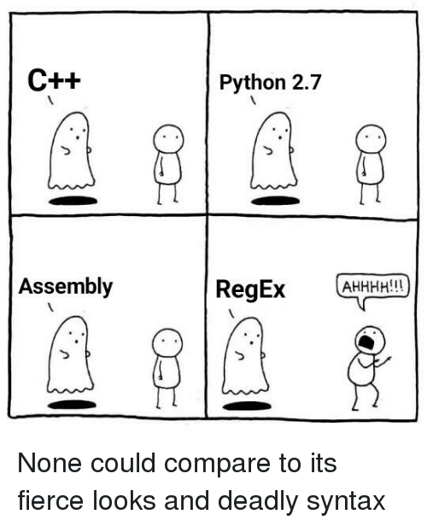
Regex - Regex
Found Python module named rstr
It has a xeger() method which allows creating a random string from a regular expression.
https://bitbucket.org/leapfrogdevelopment/rstr
Page 46
@0x48piraj
Notes:
Bsides Delhi 2019

Slide 47
Esoteric rstr bug
Unfortunately, it has a bug, which causes what I call “length explosion”, basically the length of string generated from various RegEx(s) tend to go up and up. I fixed i, and then found Xeger (https://pypi.org/project/xeger/)
>>> from xeger import Xeger >>> x = Xeger(limit=10) # default limit = 10 >>> x.xeger("/json/([0-9]+)") u'/json/15062213'
Page 47
@0x48piraj
Notes:
Bsides Delhi 2019

Slide 48
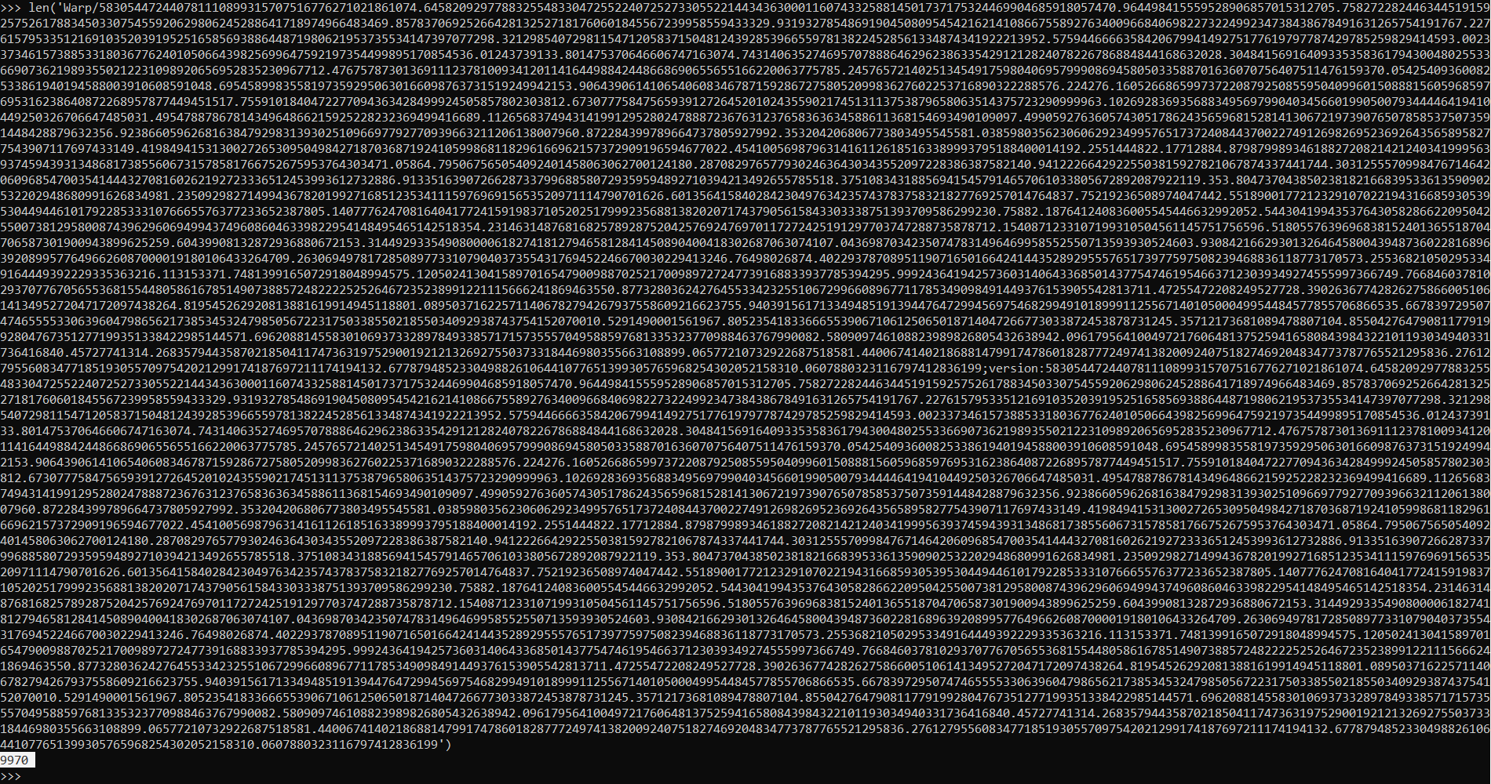
bug in action
Page 48
@0x48piraj
Notes:
Bsides Delhi 2019

Slide 49
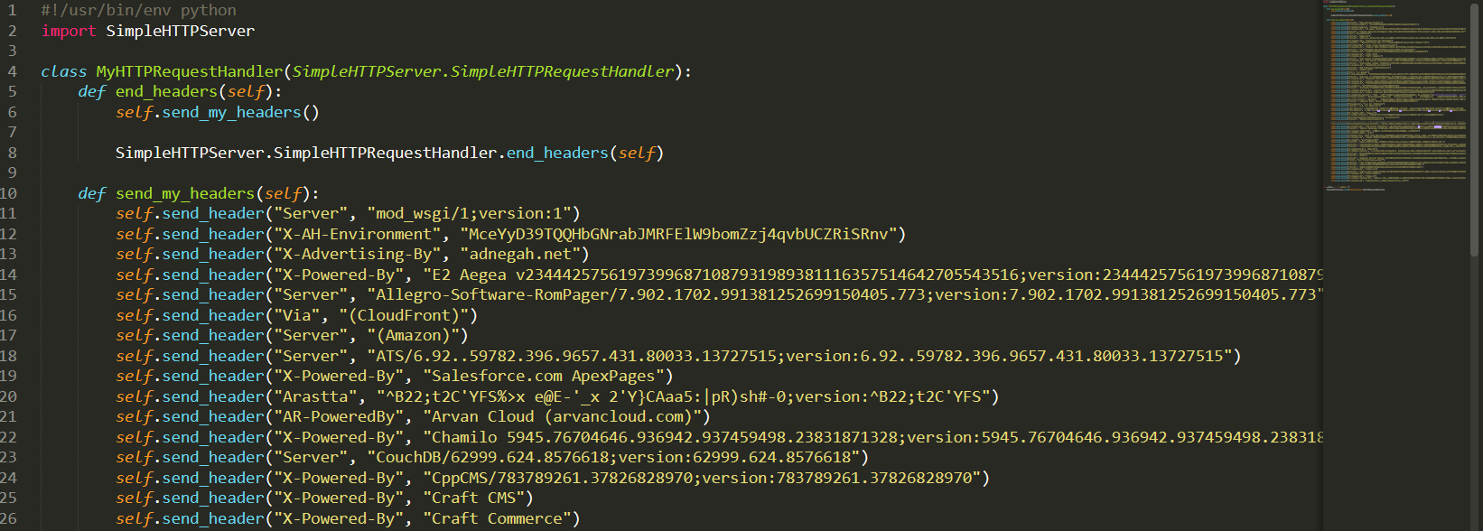
Initial testing
Generated tons of header-patterns and spewed those crafted server headers all over a bare-bone script on top of Python SimpleHTTPServer
Page 49
@0x48piraj
Notes:
Bsides Delhi 2019

Slide 50
Results ?
Page 50
@0x48piraj
Notes:
Bsides Delhi 2019

Slide 51
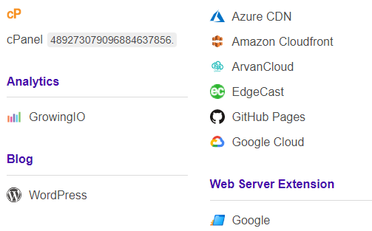
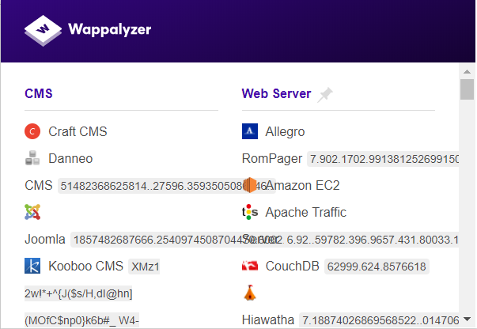
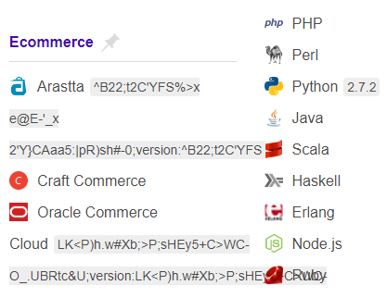
Wappalyzer going crazy
Page 51
@0x48piraj
Notes:
Bsides Delhi 2019

Slide 52
Get ready for a major remodel fellas
Started coding a command-line application which,
pull the latest apps.json from the official repository
parses all objects from apps sub-node
processes list of RegExs making them payloads which then can be utilised via either embedding them into the front-end (website) or in back-end (server)
Page 52
@0x48piraj
Notes:
Bsides Delhi 2019

Slide 53
Introducing Wapparalyser
We went through a list of names though:
WAPDEAD
Wappalyzer-seizure
Weizure (transcended from No. 2)
Confulyser (WAP-Confuse)
WAP-DESTROY-INATOR (Phineas and Ferb)
Page 53
@0x48piraj
Notes:
Bsides Delhi 2019

Slide 54
Features of Wapparalyser
Support for
Emulating services
Random
All
Certain tech-stack (e.g. MEAN, LAMP)
In-built small fuzzer for Wappalyzer
Blind
metadata|js|scripts|html|headers|cookies
Page 54
@0x48piraj
Notes:
Bsides Delhi 2019

Slide 55
THE DEMO
Page 55
@0x48piraj
Notes:
Bsides Delhi 2019

Slide 56
Impact of Wapparalyser
Breaks a company with $10M in estimated revenue annually, making their tech obsolete.
Shows current posture of a famous recon tool.
Describes the brittle nature of current methodologies.
Most probably, just another security tool which will get dusty over time.
Page 56
@0x48piraj
Notes:
Bsides Delhi 2019

Slide 57
Open Source == <3
Wapparalyser will be released under MIT license and can be found after this talk on my GitHub, 0x48piraj/wapparalyser
I’ll probably whine about the bugs/features on Twitter, so, you will get to know, easily.
Page 57
@0x48piraj
Notes:
Bsides Delhi 2019

Slide 58
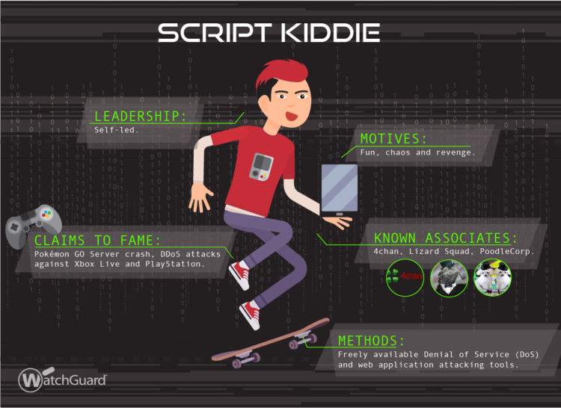
Messing with script kiddies
Page 58
@0x48piraj
Notes:
Bsides Delhi 2019

Slide 59
Messing with script kiddies
We all have coded exploits which go something like,
response = requests.get('http://target.com')
if response.status_code == 200:
print('Success!\nRunning our 1337 exploit...')
pwn(response)
elif response.status_code == 404:
print('Target Not Found. Quitting.')
Page 59
@0x48piraj
Notes:
Bsides Delhi 2019

Slide 60
Messing with script kiddies
The typical what I called “script-kiddie cycle”
We release our exploits.
Script kiddie goes to repository, blog, the source!
Does CTRL+C then CTRL+V into his Notepad.
Saves the file, tries to run the script ...
Cries in the corner if we intentionally broke some parts in our exploit.
Page 60
@0x48piraj
Notes:
Bsides Delhi 2019

Slide 61
Messing with script kiddies
What if we can break those exploits (?)
What if we can break security tools used for reconnaissance
Disclaimer: I don’t support “Security by Obscurity” in any sense but if you can increase time and money of an attacker and shoo away script kiddies without much effort, then I don’t see why not !?!
Page 61
@0x48piraj
Notes:
Bsides Delhi 2019

Slide 62
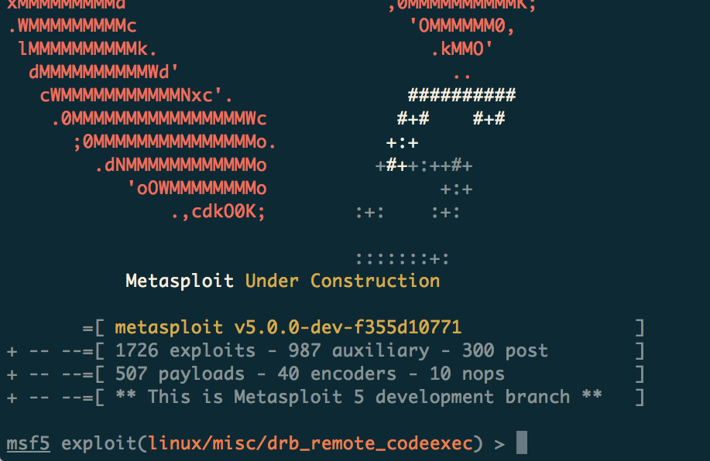
Their most favourite tool
Page 62
@0x48piraj
Notes:
Bsides Delhi 2019

Slide 63
Messing with script kiddies
Do you know how often does Metasploit reference status codes?
grep -r -E 'res[p|ponse]?\.code' * | wc
Grep search for,
res
resp
response
NOTE: The method is not reliable as it depends on how we name things.
Page 63
@0x48piraj
Notes:
Bsides Delhi 2019

Slide 64
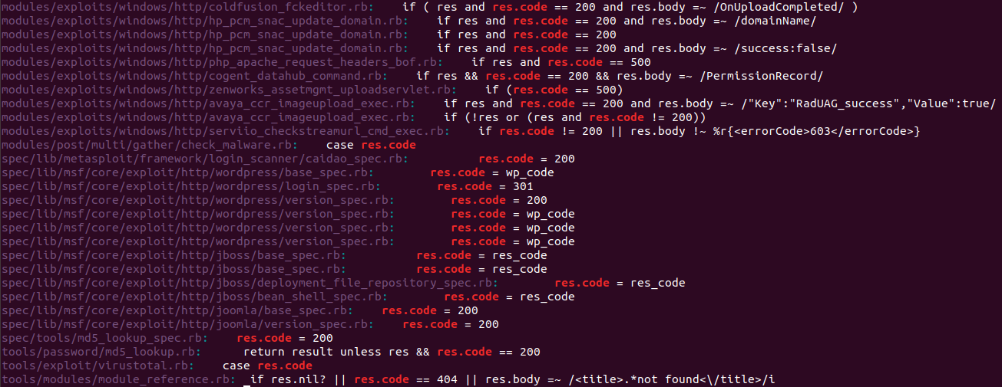
Messing with script kiddies
For keeping this research “latest”, I cloned msf master repository today. (I’ve to admit, having a cloud server is handy)
Page 64
@0x48piraj
Notes:
Bsides Delhi 2019

Slide 65
Messing with script kiddies
How can we break all the exploits ?
response = requests.get('http://target.com')
if response.status_code == 200:
print('Success!\nRunning our 1337 exploit...')
pwn(response)
elif response.status_code == 404:
print('Target Not Found. Quitting.')
Let’s suppose this is an exploit which our server is vulnerable of, if we send a 404 response code, this very exploit will FAIL
Page 65
@0x48piraj
Notes:
Bsides Delhi 2019

Slide 66
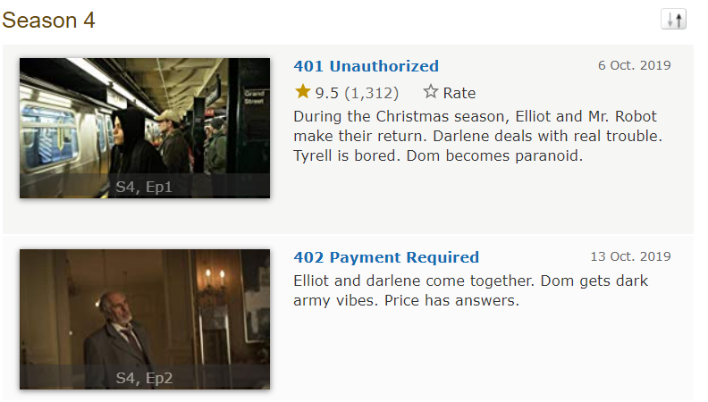
Messing with script kiddies
Same goes for,
Scanners
Web crawlers
Web-App security suites
If we’re able to change the response codes, we will create HAVOC (flood of false-positives)
Page 66
@0x48piraj
Notes:
Bsides Delhi 2019

Slide 67
Messing with script kiddies
This can be easily done by using HTTP Handler (reverse proxy) that takes an incoming request and sends it to another server, proxying the response back to the client.
Returns any response, with any HTTP status code.
Page 67
@0x48piraj
Notes:
Bsides Delhi 2019

Slide 68
What can be done?
Current methods for fingerprinting are very susceptible to attacks we discussed.
The most cheap reliable option is to do multiple tests with statistical analysis, combined with fuzzy logic techniques as we always have to make a security trade-off.
SECURITY vs RESOURCES/COST
Page 68
@0x48piraj
Notes:
Bsides Delhi 2019

Slide 69
What can be done?
New methods are also being developed, some utilizing machine learning.
Deep Fingerprinting: Undermining Website Fingerprinting Defenses with Deep Learning (Attacking TOR with DL)
Automated Website Fingerprinting through Deep Learning
Deep Web Server Fingerprinting via analysing code-base & code-use (will publish the pre-print soon)
Page 69
@0x48piraj
Notes:
Bsides Delhi 2019

Slide 70
Gist of this research
Too much RegEx matching is bad
Heavy reliance on status code leads to the dark side
New methods for fingerprinting are sorta cool
And, yeah, trusting MAC addresses for identification is a bad idea …
Page 70
@0x48piraj
Notes:
Bsides Delhi 2019

Slide 71
Thanks
Piyush Raj | @0x48piraj
https://blog.0x48piraj.com
End Page
@0x48piraj
Notes:
Bsides Delhi 2019

